Slide 1
Predicting Customer Churn at QWE Inc.
By Yikai GUO
Supervisor: David Cui

Slide 2
Background
QWE Inc.: An organization that helps small and medium-sized company manage customers through online subscription services.
Current Situation: QWE Inc. is experiencing fast growth, however, thinking there is still some space to optimize its business processes in order to further improve customer retention and reduce churn.
Collected Information: Customer Happiness Index (CHI), Change of CHI in the past month, Customer Age, Time Since Last Login, and etc.
Predictive Variable: Customer Churn - YES/NO

Slide 3
Key Problems to solve
What are the factors that could after Customer Churn? How important are they?
Can we identify a particular risk group of customers that the Customer Relationship Management (CRM) team can focus on? What are the characteristics of these customers and how can we reduce such risks?
If an customer phone call program is provided to reduce customer churn risks, how much profit would that create for QWE Inc. every year?

Slide 4
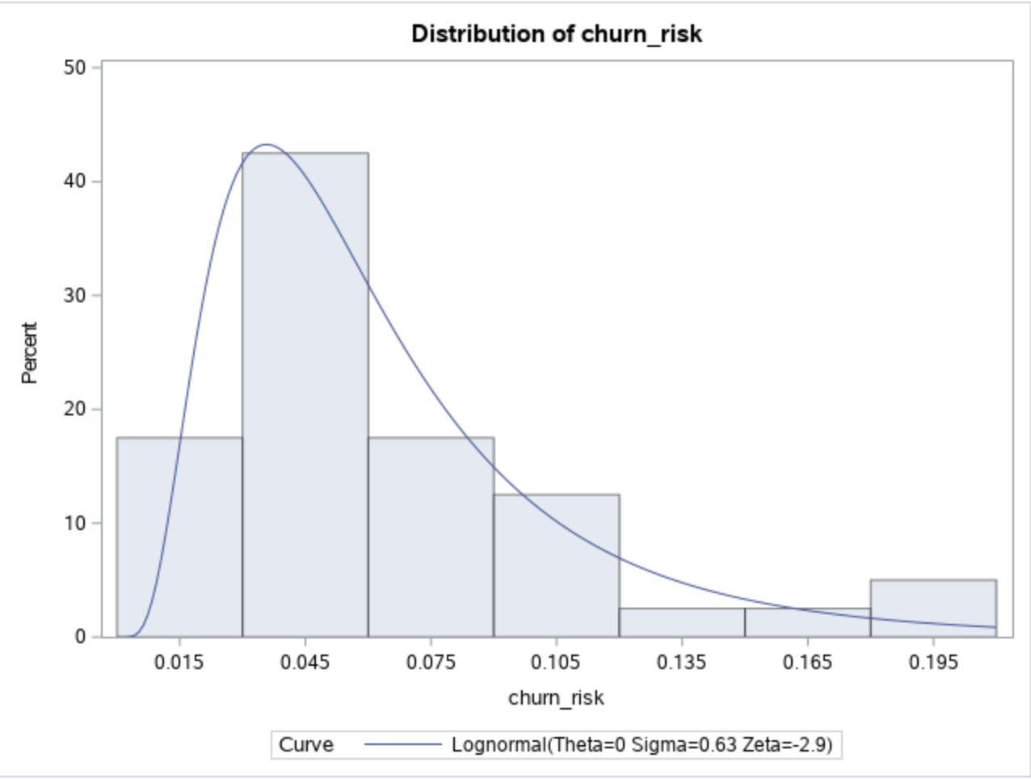
Key Factors
Different Customer Age Groups:
1-2: constant churn risk = 0
3-47: uncertain churn risk, lognormally distributed
>47: constant churn risk = 0
According to the Logistics Regression Model, there are 3 significant factors:
Customer Happiness Index: Positive impact, most important
Change in Views: Positive impact, less important
Time Since Last Login: Negative impact, least important
Views
Last Login

Slide 5
Recommendations
Cut Unnecessary Cost: Stop collecting useless information
Reduce Existing Customer’s Churn Risk
Improve Customer Happiness: Collect feedbacks and make improvements
Increase Customer’s views: Encourage customers sharing on social medias
Reduce Time Since Last Login: Send Bi-weekly reminding emails
Define Risk Groups and Focus on Such Customers

Slide 6
Risk Group
Are there specific groups of users with higher churn risks?
K-means Clustering
YES, OF COURSE!
STEP1. Use K-means clustering method to classify each significant factor into different subsets
STEP2. Run logistics model again to see any specific combination of subsets give a high churn risk output
STEP3. Select different coefficient risk levels for sensitivity analysis
STEP4. Interpret Accuracy Level by reading p-values and ROC curve plots.
Image credit: Prasad Patil
https://towardsdatascience.com/k-means-clustering-identifying-f-r-i-e-n-d-s-in-the-world-of-strangers-695537505d

Slide 7
RISK GROUP Results
RISK Group by Different Level | # of Churn Users | # of Total users | Churn Risk | Improvement
(Original) | 323 | 5583 | 5.78% | N/A
Low | 126 | 1069 | 11.79% | 104%
Medium | 118 | 863 | 13.67% | 137%
High | 32 | 142 | 22.67% | 292%
That been said, at a high risk level, there is a potential to reduce more than 10% of the total churn customers only by focusing on 2.5% of the total population.
Even better results can be obtained if assigning more clusters to each factor group.

Slide 8
Financial Impact
An option of Customer Phone Call is available to reduce churn risk at a reasonable cost
After consulting QWE Inc.’s employees and conducting marketing researches, it is discovered that
Each customer can provide approximately $100 revenue every month
Each phone call has a cost of $10
Therefore, the we can estimate the total profit under the following assumptions:
No seasonality (churn rate is constant every month for original and different risk groups)
Constant customer base growth rate of 10% every month
A customer call would reduce certain customer churn risk by 80%
Customers of age 1-2, and age >47 will not churn

Slide 9
Financial Impact cont’d
Timeline | Original Total Customer | New Total Customer | Change In Customer | Original Total Revenue | New Total Revenue | Total Net Profit | Total Net Profit in NPV* (5%) | Total Net Profit in NPV* (8%)
Current | 5583 | N/A | N/A | N/A | N/A | N/A | N/A | N/A
After 1 year | 9160 | 9647 | +5.3% | $9.4M | $9.7M | $0.3M | $0.3M | $0.3M
After 3 years | 24675 | 28594 | +15.88% | $47.8M | $52.4M | $4.6M | $4.1M | $3.9M
After 5 years | 66460 | 84027 | +26.43% | $151.1M | $178.4M | $27.3M | $22.5M | $20.1M
*NPV is the Net Present Value, and the number in brackets represents the Annual Discount Rate. It is an important indicator for long-term assessment.
In conclusion, such assumptions, the new customer-phone-call risk reduction program can:
Grow 26% more of the customer base in 5 years
Create approximately $20M net profit in NPV at an annual discount rate of 8 % in 5 years
Benefit in the long run

